Slide 1
Course Code:CSC402A Course Title: Web Architecture and Application Development
Course Leader:
Kishore S.M.
kishore.cs.et@msruas.ac.in

Slide 2
Objectives
After completing this lecture, the student will be able to
Apply and Analyze Enterprise Java beans
Analyze batch applications in java
Analyze JMS

Slide 3
Contents
EJB’s
Batch processing in java
Java Messaging services

Slide 4
Enterprise Java Beans
A server-side component technology
Used to encapsulate the business logic of an application
Reusable components that run inside a EJB container, a runtime environment provided by the application server
Easy development and deployment of Java technology-based application that are:
Transactional, distributed, multi-tier, portable, scalable, secure

Slide 5
EJB Architecture
Application Server
EJB Container
Browser
EJB Server
Database
Transactions
Security

Slide 6
EJB Server
Provides services for the EJB container
Concerned with the oﬀered middleware services
Services for communication, security, transaction, persistence, etc.
The EJB server does not take part in the logical conversation between client and EJB bean
The server must handle requests for the container and feed the container incoming client requests
All access is performed against the container

Slide 7
EJB Container
EJB Life cycle management (creation to destruction)
Isolates the developer from platform dependent APIs
EJB Container provides support for
Persistence
Access control
Transactions

Slide 8
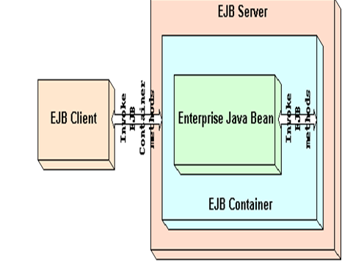
EJB Container
Interface between EJB & outside world
EJB Clients never access an EJB directly- any access is done through container-generated methods in turn invoke bean methods

Slide 9
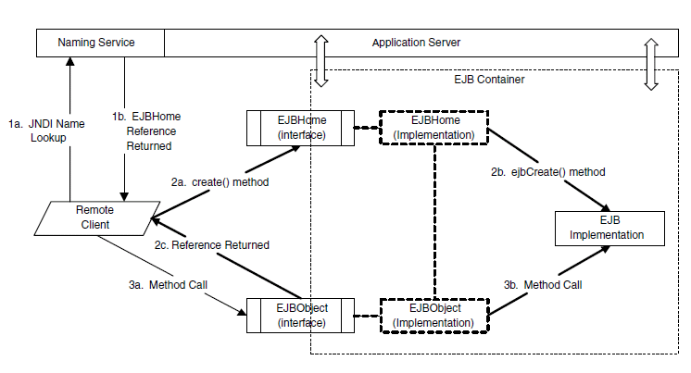
A Typical EJB

Slide 10
A Typical EJB contd.
A client first connects to the EJBHome interface through a JNDI name lookup
Then the client executes a create() method against the EJBHome object
The container takes over, creates an implementation instance and an EJBObject instance, and returns a reference to the EJBObject
The client executes a method against the EJBObject
Once again, the container intercepts the call and issues the command to the EJB implementation, which executes the method

Slide 11
Features of the EJB Architecture
The EJB bean exists within the container
The client never communicates directly with the EJB bean
It talks to the bean through its home interface and its remote interface
The remote or local interfaces
Deﬁne a bean’s business methods
The home interfaces
Represent its life cycle methods (e.g. create, destroy), called by the application server to manage the beans

Slide 12
Enterprise Java Beans
Enterprise JavaBeans
Synchronous communication
Asynchronous communication
Session Bean
Entity Bean
Message-Driven Bean
Stateless
Stateful
Bean managed
Persistence
(BMP)
Container managed
Persistence
(CMP)

Slide 13
Session Bean
A reusable component that encapsulates business logic of an enterprise application
Execute on behalf of a single client
A client code accesses the session bean deployed on the application server and invokes methods that perform tasks inside the application server
Their lifetime is limited to that of the client and hence they are relatively short-lived
They do not survive server crashes
They do not represent data in the database
Their identity is hidden

Slide 14
Stateless Session Bean
Do not maintain any conversational state
Each method is completely independent and uses only data passed in its parameters
Capable of handling multiple clients when no client speciﬁc data is needed
The state of a stateless session bean is shared by all the clients using it
A container can easily handle a state-less Session bean
Instances of a stateless bean can be created and destroyed at will, without knowing about their state at the time of their destruction

Slide 15
Stateful Session Bean
Used to represent the state of a client session
One Session Bean object per client
A Stateful Session bean is a bean that changes state during a conversation
That change can affect subsequent method calls
Hold information about the client between the method invocations
If the client stops using the stateful session bean, it discarded and the state disappears

Slide 16
Entity Beans
Used to represent business data in an application
Correspond with information stored in databases or other persistent storage
Have primary key
Participate in transactions
Long-lived
Can survive EJB server clashes
Multiple clients can access and work with the same entity bean
When not used
Preserved in persistent location and returned to the pool
When used
Can be cached

Slide 17
Bean Managed Persistence (BMP)
The author of the bean must write any necessary database calls to send the object out to persistent storage and read it back in again
To implement bean-managed persistence, we would place our database calls in the ejbLoad() and ejbStore() routines
The container calls ejbLoad() to notify the object that it should land its state in from a database
The ejbStore() notifies the object that it should write its state out to the database

Slide 18
Container Managed Persistence
Container managed beans have their persistence automatically managed by the EJB container
Bean developer does not implement the persistence logic
The developer relies on the development descriptor to specify attributes whose persistence should be managed by the container

Slide 19
Message-Driven Beans
Asynchronously receives and processes messages sent by the Java EE components or other applications using the JMS
Called JMS message consumers
Listen from a message from JMS server
Performs a set of actions defined when message is received
Do not have home or remote interface
They do not maintain any client-speciﬁc data

Slide 20
Message-Driven Beans contd.
Reliably consume message
Clients of message-driven beans do not communicate with them directly by invoking methods
Instead, a client sends a message to the message destination assigned to a speciﬁc message-driven bean
Incoming messages are processed as soon as they arrive by the message-driven bean’s onMessage method

Slide 21
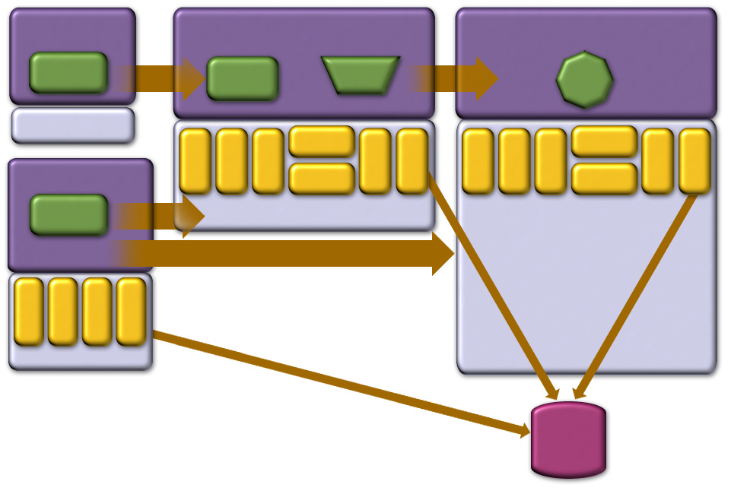
JEE Containers
Applet Container
Web Container
EJB Container
Applet
HTTP/ HTTPS
JSP
Servlet
RMI
EJB
J2SE
JavaMail
RMI/IIOP
JavaMail
RMI/IIOP
JNDI
JMS
JTA
JDBC
JNDI
JMS
JTA
JDBC
App Client Container
JAF
JAF
App Client
HTTP/ HTTPS
J2SE
RMI
JNDI
RMI/IIOP
JDBC
JMS
J2SE
J2SE
Database

Slide 22
Batch Applications for Java Platform
Suited for non-interactive, bulk-oriented, and long-running tasks
Batch execution: sequential, parallel, decision-based
Processing Styles
Item-oriented: Chunked (primary)
Task-oriented: Batchlet

Slide 23
Batch Applications for Java Platform
The ability to execute batch jobs from Java EE is very important for many enterprise customers
The new Batch Applications for Java API is therefore targeted at non-interactive, bulk-oriented, long-running tasks
It allows you to customize the handling of these jobs in terms of their individual steps. You can specify sequential or parallel execution as well as decisions that direct the execution path
The Batch API also provides for check pointing and callback mechanisms

Slide 24
Batch Applications for Java Platform
An individual batch job step may itself be a "chunk", whereby you can specify separately the handling of the input, the processing, and the output of the individual items that are part of the chunk.
Or a step may be a "batchlet", which provides a more roll-your-own style of the step task's execution.

Slide 25
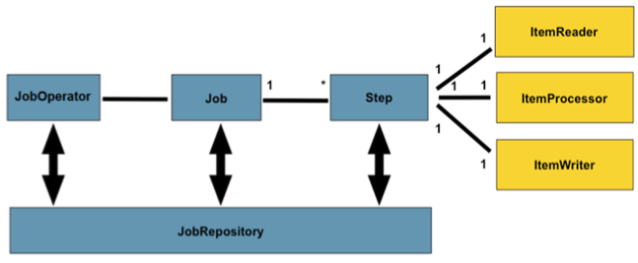
Batch Applications for Java Platform
Manage
batch process
Chunk
Metadata for jobs

Slide 26
Batch Applications for Java Platform
A Job is an entity that encapsulates an entire batch process
A Job will be wired together via a Job Specification Language
A Job has one to many steps, which has no more than one It emReader, ItemProcessor, and ItemWriter
A job needs to be launched (JobOperator), and meta data about the currently running process needs to be stored (JobRepository)
A Step is a domain object that encapsulates an independent, sequential phase of a batch job

Slide 27
Batch Applications for Java Platform
A job repository holds information about jobs currently running and jobs that have run in the past
The JobOperator interface provides access to this repository
The repository contains job instances, job executions, and step executions
ItemReader is an abstraction that represents the retrieval of input for a Step, one item at a time
ItemWriter is an abstraction that represents the output of a Step, one batch or chunk of items at a time

Slide 28
Batch Applications for Java Platform
ItemProcessor is an abstraction that represents the business processing of an item
While the ItemReader reads one item, and the ItemWriter writes them, the ItemProcessor provides access to transform or apply other business processing

Slide 29
Java Message Service
New JMSContext interface
AutoCloseable JMSContext, Connection, Session, …
Use of runtime exceptions
Method chaining on JMSProducer
Simplified message sending

Slide 30
Java Message Service
A big focus area of Java EE 7 is in increasing developer productivity by continuing our trend in offering simpler and easier-to-use APIs and in offloading developer tasks onto container services
JMS in particular has undergone a major simplification with the JMS 2.0 release which is part of Java EE 7
The JMSContext combines in a single object the functionality of both the Connection and the Session in the earlier JMS APIs
You can obtain a JMSContext object by simply injecting it with the @Inject annotation

Slide 31
Summary
Different Java platforms are
Java Standard Edition
Java Micro Edition
Java Enterprise Edition
A JEE application server consists of
A Web container
An EJB container
Servlets are Java objects which extend the functionality of a HTTP server
JSP pages are HTML pages with embedded Java
EJB is a server-side component technology

